Slide 1


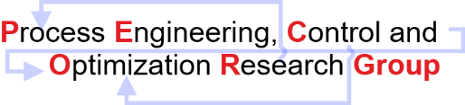
Artificial Neural Network
Model
Discipline of Chemical Engineering,
Indian Institute of Technology Gandhinagar,
Palaj, Gujarat – 382055
India

Slide 2
Artificial Neural Network
CASE STUDY 1: ANN for top 20 features selected using decision tree algorithm
On four months of data.
No of input (statistical features) | 20
No of hidden layer | 1
No of units in hidden layer | 50
Activation function for hidden layer | RELU
Activation function for output layer | SIGMOID
Test data length | 472 (80%)
Train data length | 119 (20%)
Loss function | Binary cross entropy
Metrics | Accuracy
Optimizer | Adam
Epochs | 150
Batch Size | 5
Regularization | L2 (Regularization Strength:0.01)
Random Shuffling | random_state =42
Train Accuracy | Test accuracy
64.41% | 58.82%

Slide 3
Artificial Neural Network
CASE STUDY 2: ANN for top 20 features selected using random forest algorithm
On four months of data.
No of input (statistical features) | 20
No of hidden layer | 1
No of units in hidden layer | 50
Activation function for hidden layer | RELU
Activation function for output layer | SIGMOID
Test data length | 472 (80%)
Train data length | 119 (20%)
Loss function | Binary cross entropy
Metrics | Accuracy
Optimizer | Adam
Epochs | 150
Batch Size | 5
Regularization | L2 (Regularization Strength:0.01)
Random Shuffling | random_state =42
Train Accuracy | Test accuracy
69.92% | 63.87%

Slide 4
Artificial Neural Network
CASE STUDY 3: ANN for features common features.
No of input (statistical features) | 8
No of hidden layer | 1
No of units in hidden layer | 50
Activation function for hidden layer | RELU
Activation function for output layer | SIGMOID
Test data length | 472 (80%)
Train data length | 119 (20%)
Loss function | Binary cross entropy
Metrics | Accuracy
Optimizer | Adam
Epochs | 150
Batch Size | 5
Regularization | L2 (Regularization Strength:0.01)
Random Shuffling | random_state =42
Common features were selected using the intersection of the top 20 features obtained using random forest and decision tree algorithm.
Train Accuracy | Test accuracy
65.04% | 54.62%

Slide 5
Artificial Neural Network
Iterative Feature selection process.
This selection process was followed to obtain the best subset of features and maximum accuracy that can be achieved with the following ANN architecture.
No of hidden layer | 1
No of units in hidden layer | 50
Activation function for hidden layer | RELU
Activation function for output layer | SIGMOID
Test data length | 472 (80%)
Train data length | 119 (20%)
Loss function | Binary cross entropy
Metrics | Accuracy
Optimizer | Adam
Epochs | 150
Batch Size | 5
Regularization | L2 (Regularization Strength:0.01)
Random Shuffling | random_state =42

Slide 6
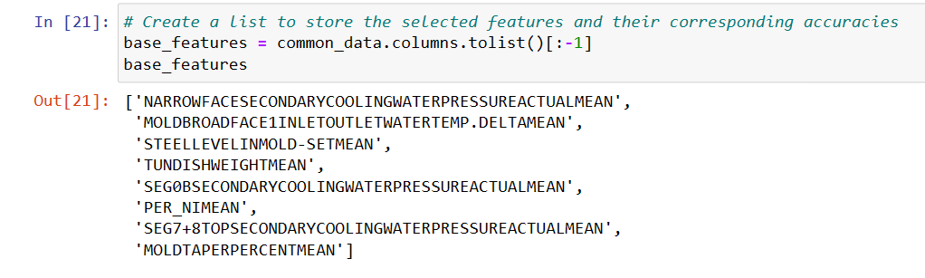
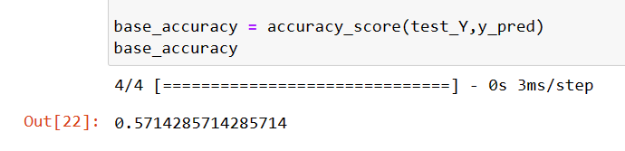
Artificial Neural Network
CASE STUDY 4: Iterative Feature selection process .
Algorithm
Selected base features and initialized base model. Base features are the common features used in case study 3. After fitting the model the base accuracy was calculated.

Slide 7
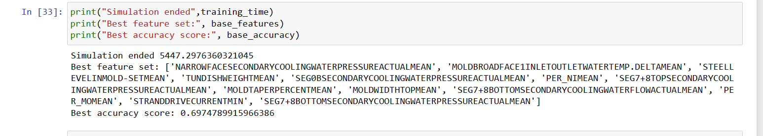
Artificial Neural Network
CASE STUDY 4: Iterative Feature selection process .
Algorithm
Added one feature one by one. The Random forest ranked the features in descending order based on importance score. Using that list the features were added one by one.
Evaluation was done. At each iteration, the accuracy was calculated for a new subset of features.
Comparison was done. At each iteration if the accuracy for a new subset of features improved than the base accuracy than that feature was appended to the base feature.

Slide 8
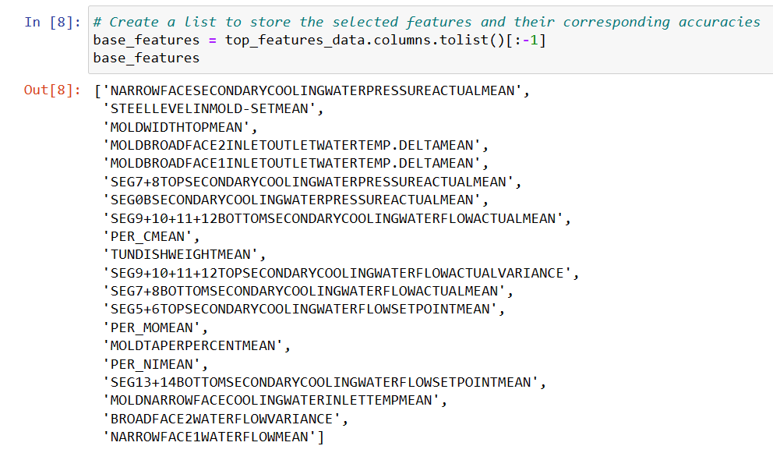
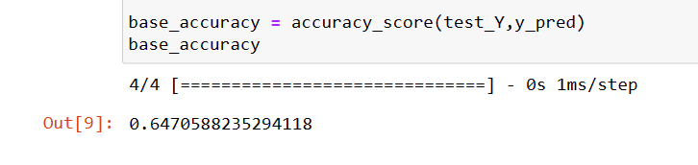
Artificial Neural Network
CASE STUDY 5: Iterative Feature selection process .
The same Algorithm was followed after taking the top 20 features achieved from the random forest algorithm for training the base model and then calculating the best subset of features and the best accuracy that can be achieved.

Slide 9
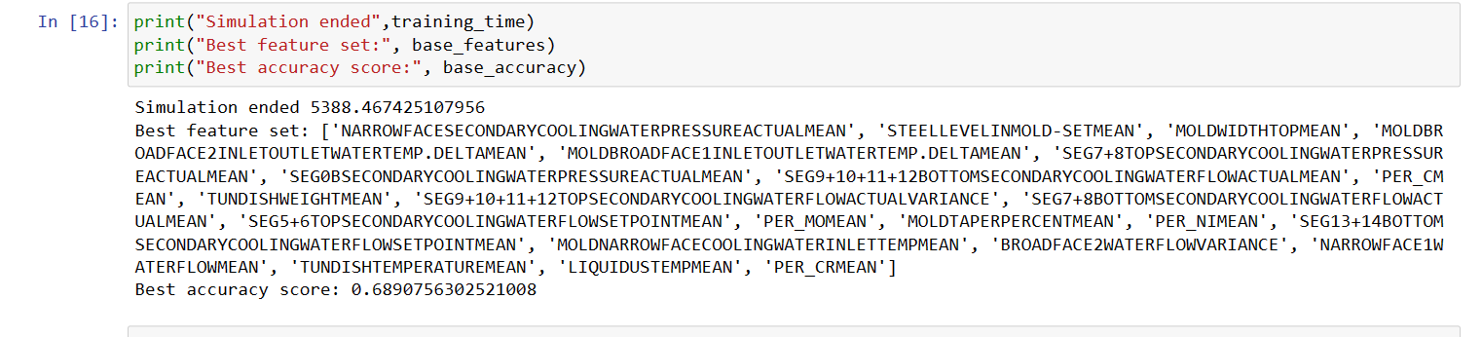
Artificial Neural Network
CASE STUDY 5: Iterative Feature selection process .

Slide 10
Artificial Neural Network
Future Work
We will extend this Iterative Feature Selection to find the maximum possible accuracy that can be achieved with the dataset and the statistical features which will contribute to achieving maximum accuracy that can be achieved with the dataset.
Hyperparameter on the base model is yet to be explored to find the best set of parameters that can help in achieving much better accuracy than 57% and 64% of the base model.
Once the code for the above four months is developed, then the same procedure can be followed for the dataset of HCMA and HC grade category.
Will try to implement methods like gradient boosting and others mentioned in the papers suggested to see whether accuracy improves or not.

Slide 11
Artificial Neural Network
Best configuration choice for the base model features that come from the intersection of the top 20 features in the decision tree and random forest algorithm.
Type of Scaler | Regularization | Types of Batch Size | Type of Optimizer | Train Accuracy | Test Accuracy
Robust Scaler | L1(0.01) | Mini Batch Gradient Descent (batch size=5) | Adam | 68.01% | 57.98%
Robust Scaler | L2(0.01) | Mini Batch Gradient Descent (batch size=5) | Adam | 71.4% | 64.71%
Standard Scaler | L2(0.01) | Mini Batch Gradient Descent (batch size=5) | Adam | 74.79% | 65.55%
Minmax Scaler | L2 (0.01) | Mini Batch Gradient Descent (batch size=5) | Adam | 51.91% | 47.06%
Robust Scaler | L2 (0.01) | Batch Gradient Descent (batch size=len(trainX)) | Adam | 71.61% | 67.23%
Robust Scaler | L2 (0.01) | Batch Gradient Descent (batch size=len(trainX)) | rmsprop | 68.86% | 66.39%
Robust Scaler | L2 (0.01) | Batch Gradient Descent (batch Size=len(trainX)) | SGD(momentum=0.9) | 72.88% | 71.43%
Robust Scaler | L2 (0.01) | Stochastic Gradient Descent (batch Size=1) | SGD(momentum=0.9) | 48.09% | 47.06%
Note: The condition for the output column has been changed and code reproducibility has been resolved.

Slide 12
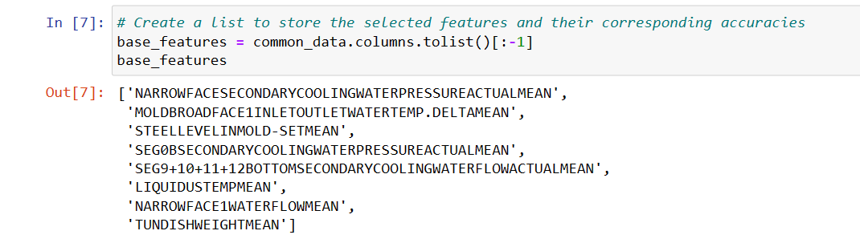
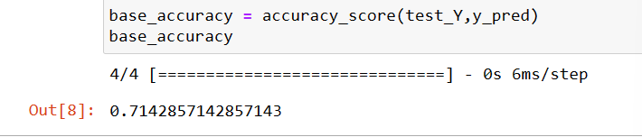
Artificial Neural Network
CASE STUDY 6: Iterative Feature selection process.
Changes were made in the previous codes for evaluating the final output value.
After making the changes and selecting the best configuration for the base model, the model was trained again using the same algorithm mentioned before.

Slide 13
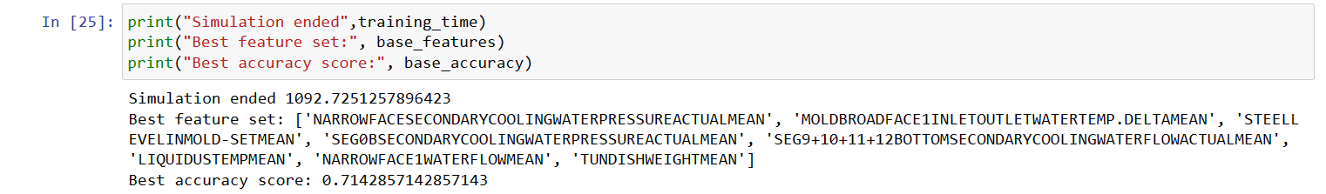
Artificial Neural Network
CASE STUDY 6: Iterative Feature selection process.
The critical features and corresponding accuracy identified that contribute most to crack prediction in a continuous casting process using the base model features are those that came from the intersection of the decision tree and random forest algorithm.
The accuracy has not improved by adding any feature other than base features.

Slide 14
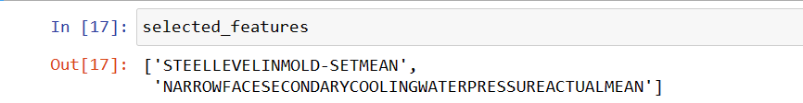
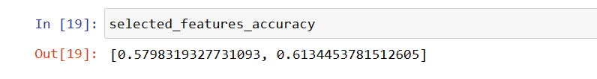
Artificial Neural Network
CASE STUDY 7: Step wise feature selection process.
Initialize the base feature set with the first feature ranked by random forest.
Train an ANN model using only the base feature and record the test accuracy.
For each remaining feature:
Add the current feature to the base feature set.
Train an ANN model using the updated feature set.
Record the test accuracy of the model.
Identify the subset that achieved the maximum accuracy among all subsets.
If the maximum accuracy is higher than the previous accuracy:
Update the base feature set with the selected subset.
Update the previous accuracy with the maximum accuracy.
Repeat steps 3-5 till the maximum accuracy comes out to be less than the previous accuracy.
If the maximum accuracy is not better than the previous accuracy, stop the process as no subset improved upon the previous result.

Slide 15
Artificial Neural Network
Future Work
The step-wise algorithm started with the feature ranked as most important by the random forest but it is just giving an accuracy of 57.9% which is very low.
So in the next case study we can first start with the feature which will give the maximum accuracy and repeat the algorithm the same as in case study 6.
Once this code for the above four months is developed, then the same procedure can be followed for the dataset of HCMA and HC grade category.
As we have to see whether compositions and micro-alloy components appear in feature selection or not, hopefully, grade-wise analysis can indicate that.

